Slide 1

Under-the-water biosecurity and health management: FAO perspectives and initiatives
Melba.Reantaso@fao.org
Bin.Hao@fao.org
Brett.Mackinnon@fao.org

Slide 2
Topics
FAO:
  who we are, what we do and where are we
  SOFIA 2020: Aquaculture trends
Trends in disease situation in aquaculture
  Significant diseases in Latin America and the Caribbean
  Under-the-water biosecurity and health management and drivers
Progressive Management Pathway for Improving Aquaculture Biosecurity
Viewpoint paper: SARS-CoV-2 (The Cause of COVID-19 in Humans) is Not Known to Infect Aquatic Food Animals Nor Contaminate Their Products

Slide 3

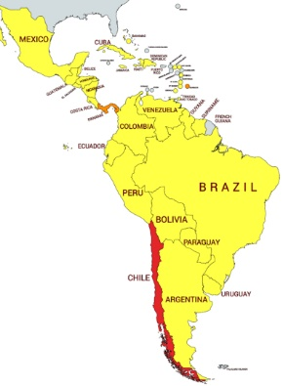
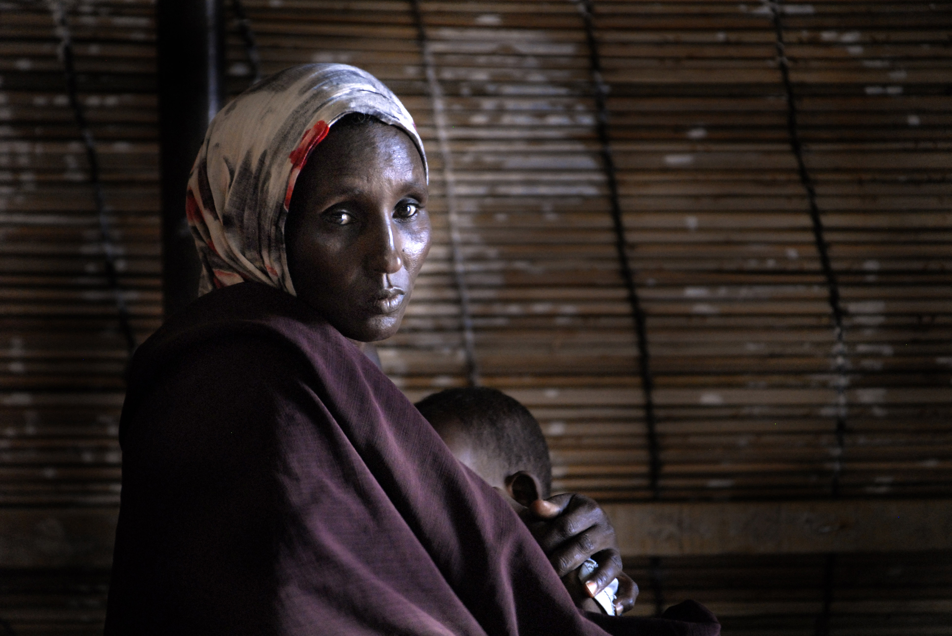
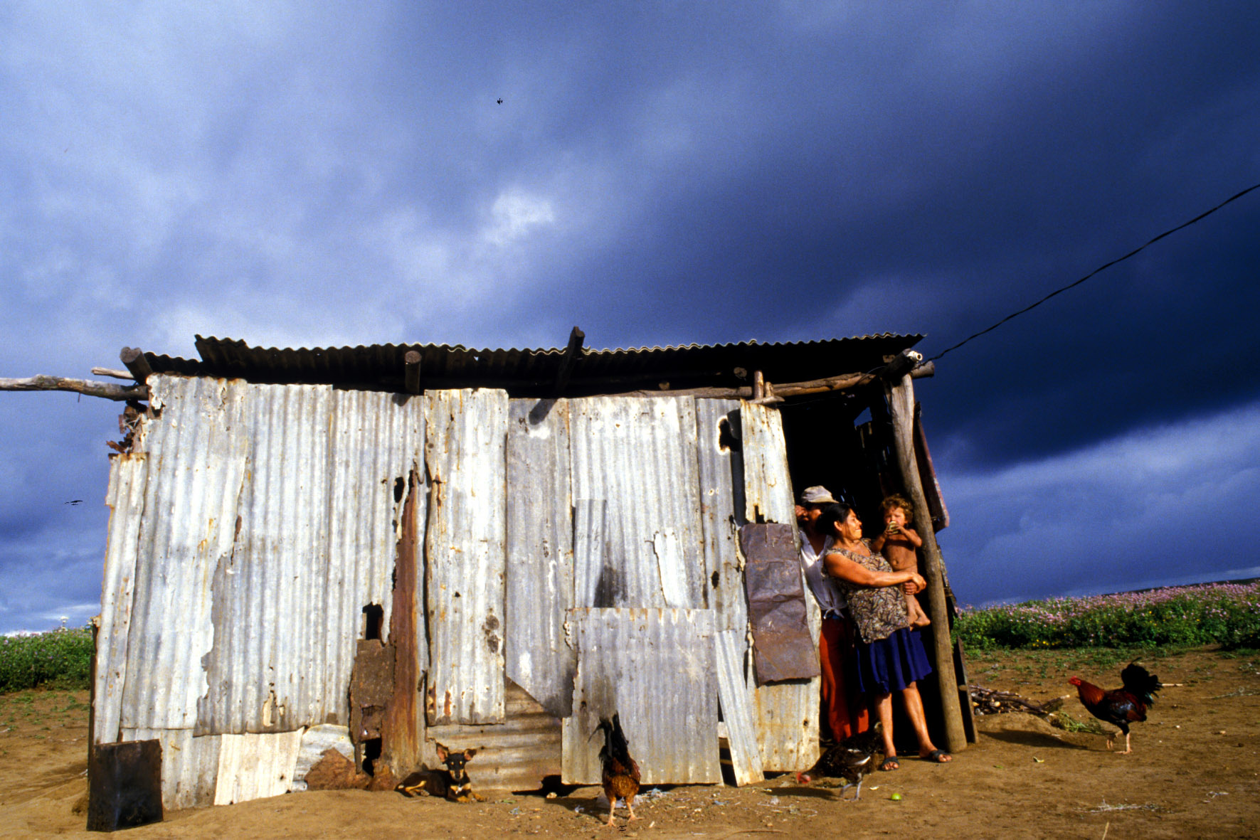
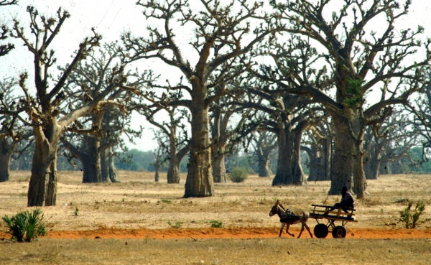
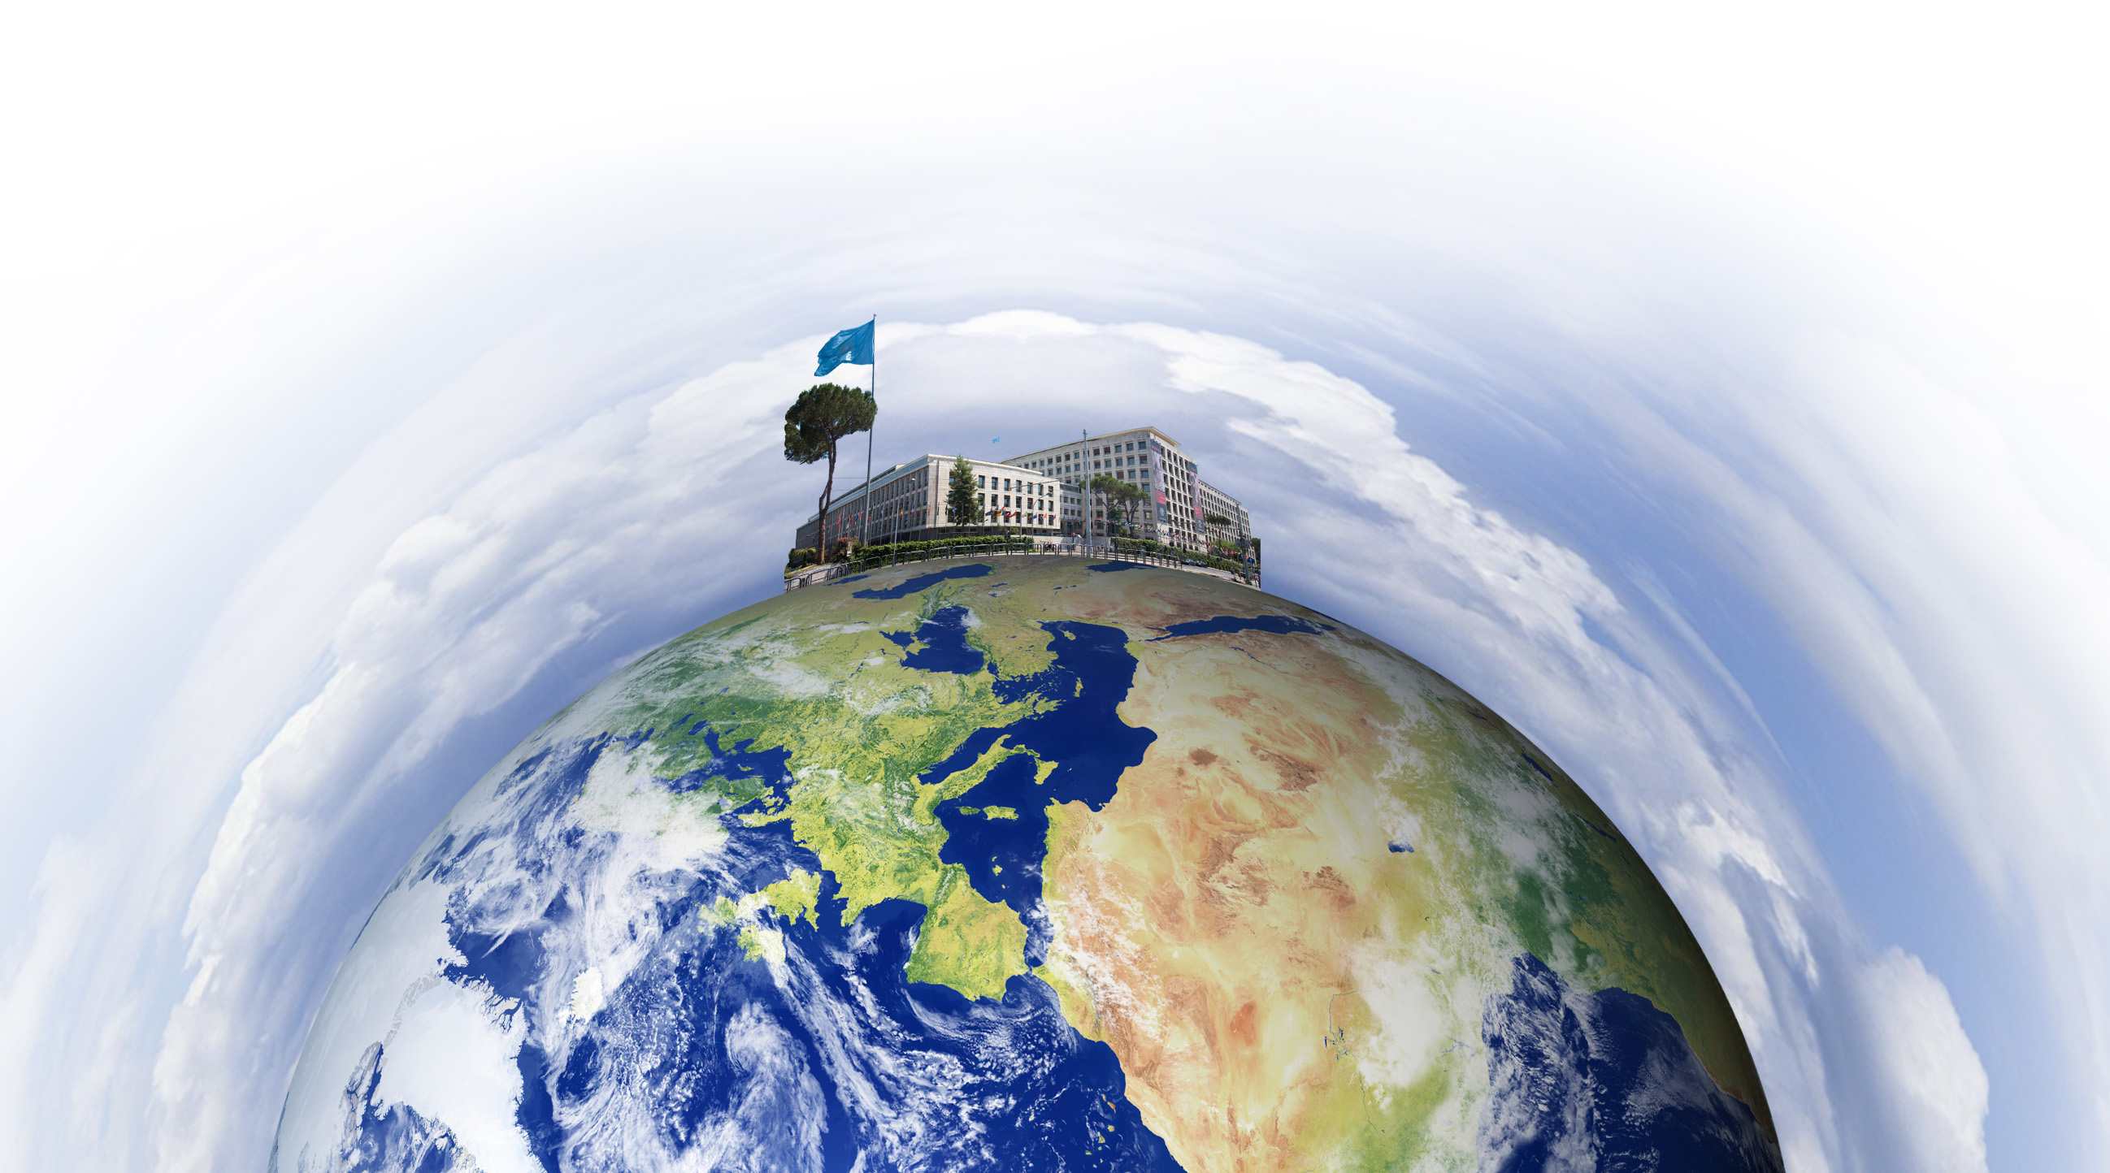
Eradicate hunger, food insecurity and malnutrition
Eliminate rural poverty through socio-economic development
Sustainable management and utilization of natural resources

Slide 4

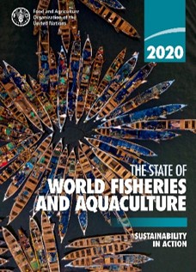
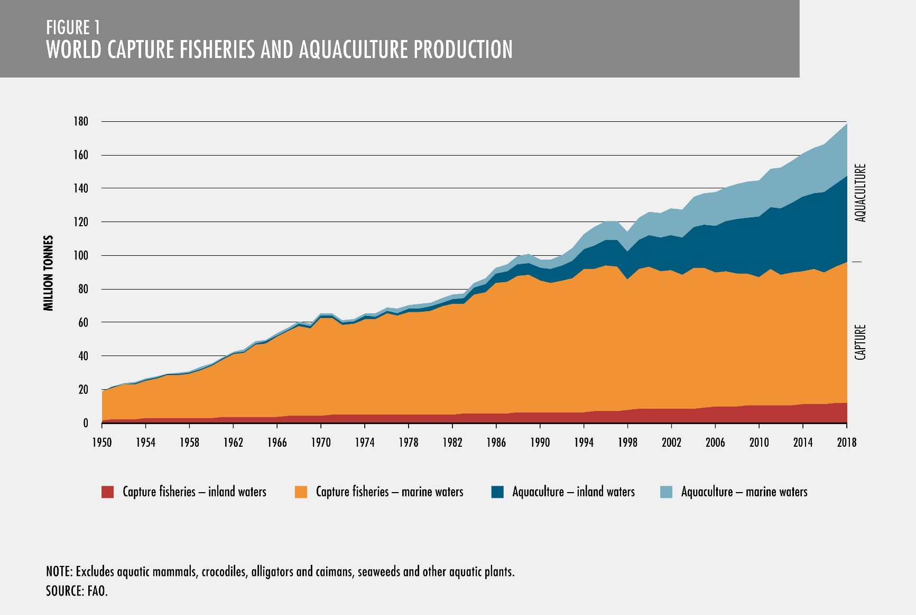
Add text
http://www.fao.org/publications/sofia/2020/en/
Notes:
I would like to start by reviewing the state of world fisheries and aquaculture, as conveyed through our flagship publication, SOFIA 2018. Since 1994 and for the past twenty-four years, SOFIA has been published every two years in six languages. SOFIA 2018 is the thirteenth edition in the biennial series.
SOFIA, as an FAO flagship publication that serves as a global reference for all those working in or seeking information about the fisheries and aquaculture sectors, documents global trends and statistics and sets future directions for work in fisheries and aquaculture. Various evaluations have demonstrated the growing interest for SOFIA, including the statistic that it is web-accessed over 1,500 times a day, every day of the year.

Slide 5
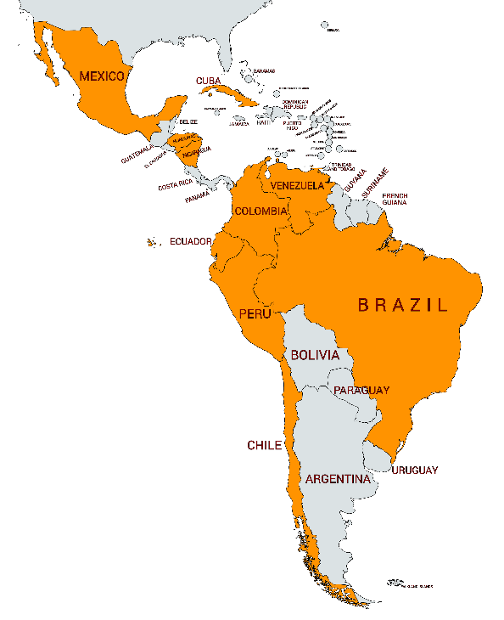
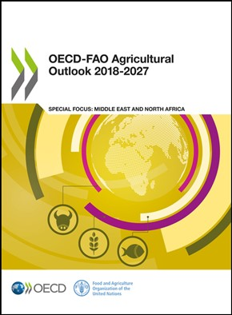
Top 10 aquaculture producers
Country | Quantity (thousand tonnes) | Value (USD)
1. Chile | 1,287 thousand tonnes | USD 10.50 billion
2. Brazil | 606 thousand tonnes | USD 1.35 billion
3. Ecuador | 540 thousand tonnes | USD 2.80 billion
4. Mexico | 247 thousand tonnes | USD 0.81 billion
5. Colombia | 133 thousand tonnes | USD 0.39 billion
6. Peru | 104 thousand tonnes | USD 0.42 billion
7. Honduras | 65 thousand tonnes | USD 0.26 billion
8. Nicaragua | 29 thousand tonnes | USD 0.08 billion
9. Venezuela | 29 thousand tonnes | USD 0.12 billion
10. Cuba | 29 thousand tonnes | USD 0.04 billion
Chapter 8: Fish and seafood: Project highlights
For production, these include issues related to … transboundary issues with respect to … diseases and escapes…
Notes:
These are the top 12 aquaculture producers. Except for Egypt, Norway and Chile ranked 6th, 7th and 8th respectively all are Asian producers + Japan. The recently released OECD-FAO Agricultural Outlook 2018-2027 highlighted that transboundary issues such as diseases and escapes will affect aquaculture production.

Slide 6





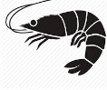
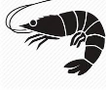

Chronology of Pathogen/Disease Emergence in Aquaculture
Parasites Bacteria Virus Fungi
ISA (salmon)
IPNV (tilapia)
Sea lice (salmon)
WSSV, HPV, IHHNV, BP (shrimp)
NHP (shrimp)
MoV, IMNV, CMNV, LSNV (shrimp)
AHPND (shrimp)
TiLV (tilapia)
VNN (tilapia and marine finfish)
EHP Enterocytozoon hepatopenaei (shrimp)
These pathogens affect all phases of production (hatchery, nursery, grow-out).
1970s
1990s
Future
1980s
2000s
Gyrodactylus (salmon)
MBV (shrimp)
LCDV (tilapia)
EUS (many finfish)
YHV, TSV (shrimp)
Vibriosis: Vibrio (harveyi, damsela, alginolyticus, vulnificus, penaeicida) (shrimp)
KHV (carps/koi carp)
We expect more diseases (exotic, endemic, emerging) if no biosecurity actions are taken
Omar Elhassan (FIAA)

Slide 7
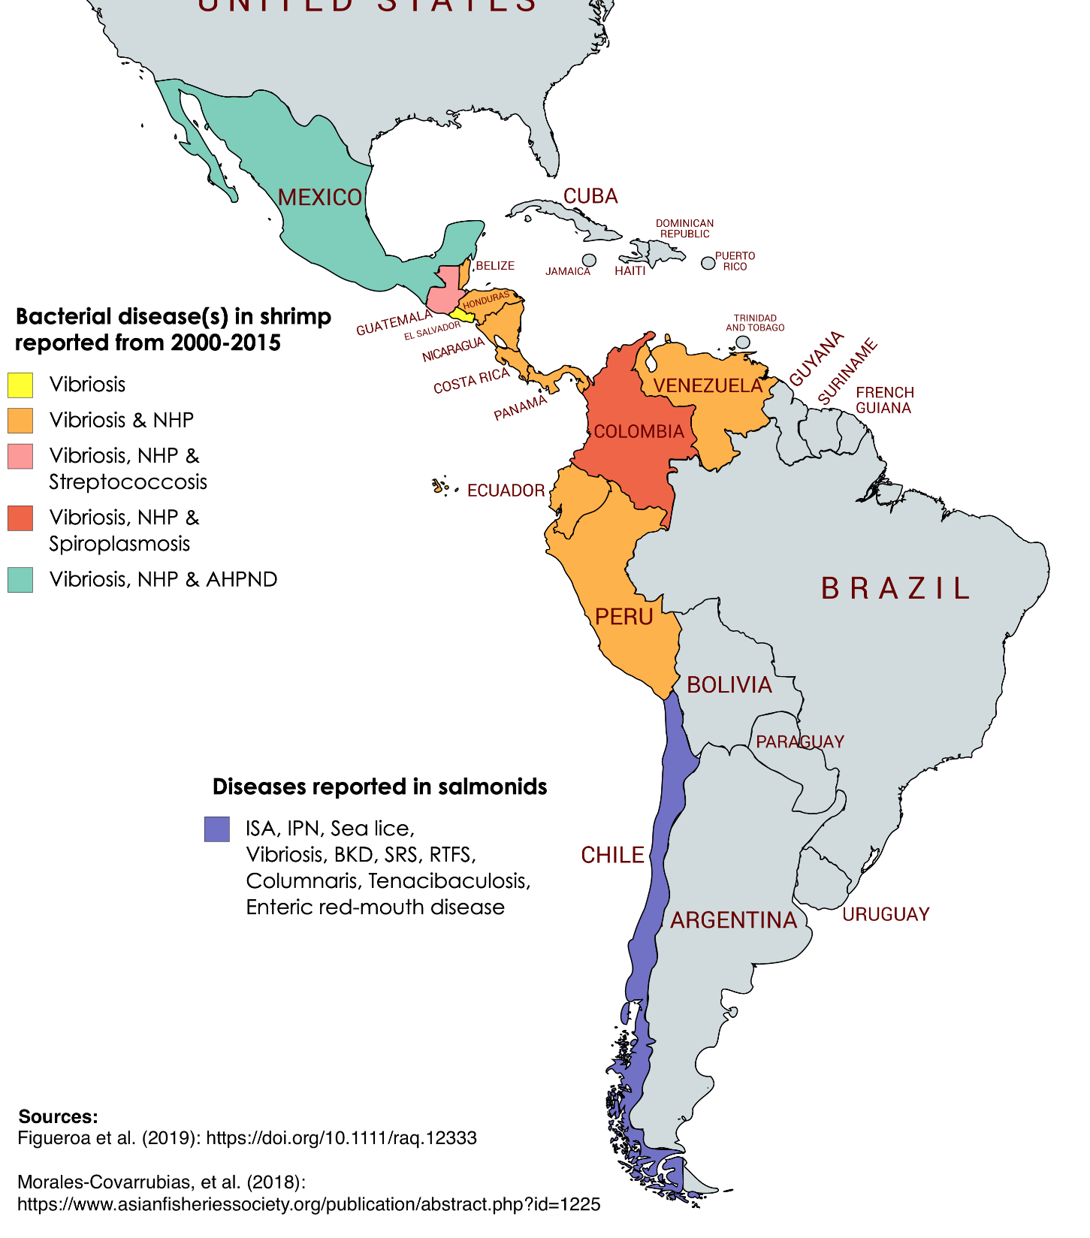
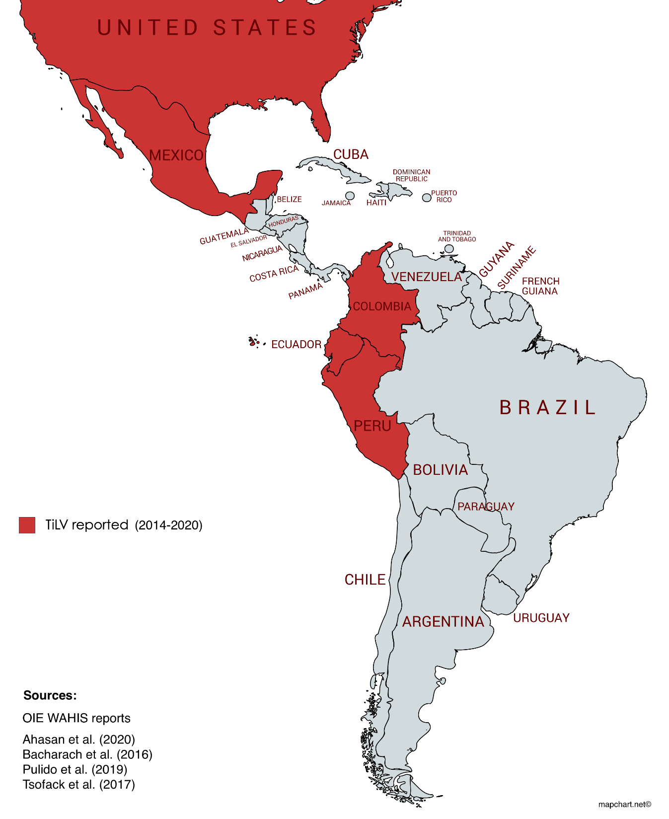

Slide 8
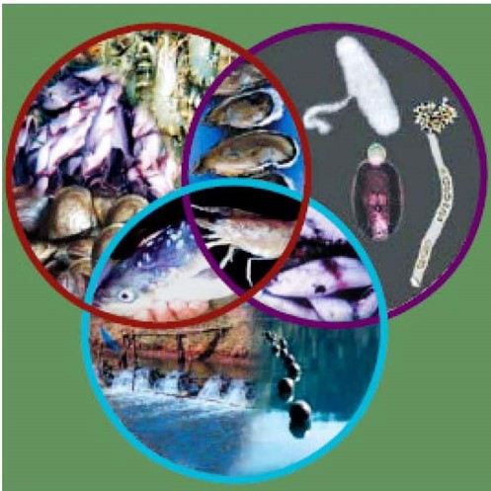
Under-the-water biosecurity and health management
Factors, drivers and pathways to aquatic animal disease emergence in aquaculture
Aquatic management and health control
Ecosystem change
Knowledge of pathogens and their hosts
Trading in live animals and products
Factors, drivers and pathways DISEASE EMERGENCE
Notes:
Under-the-water animal health
Not readily visible
Complex and dynamic aquatic environment
Linked events involving the interactions between the host, the environment and the presence of a pathogen
Disease spread from farmed to wild population & vice-versa

Slide 9
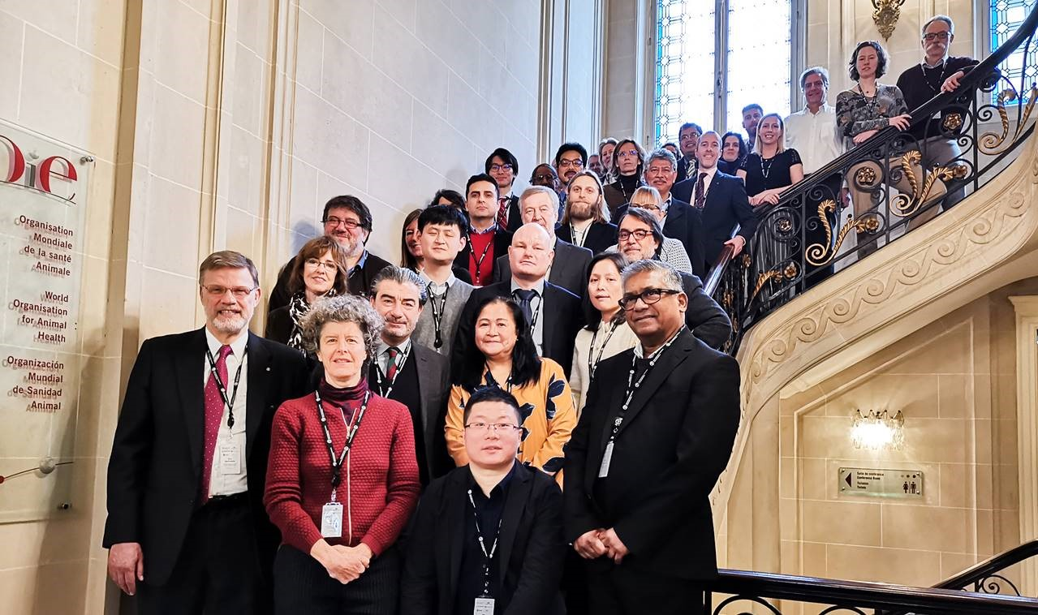
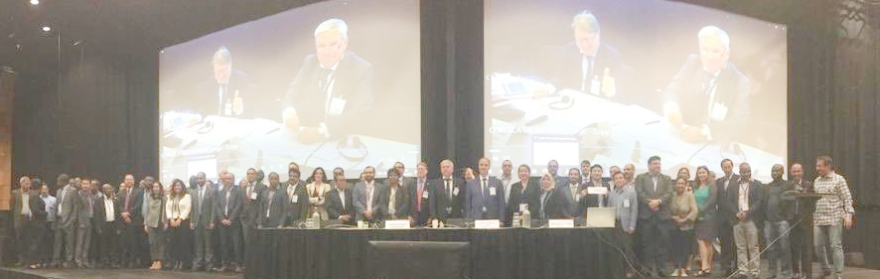
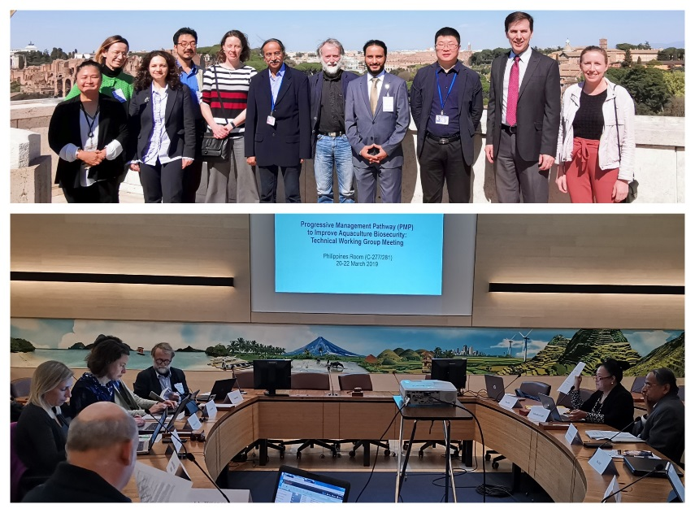
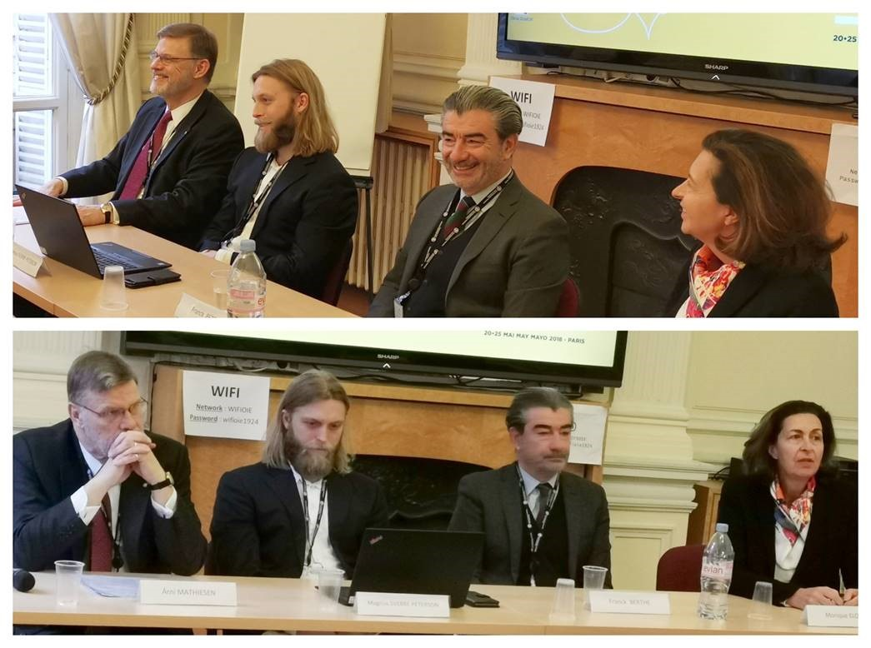
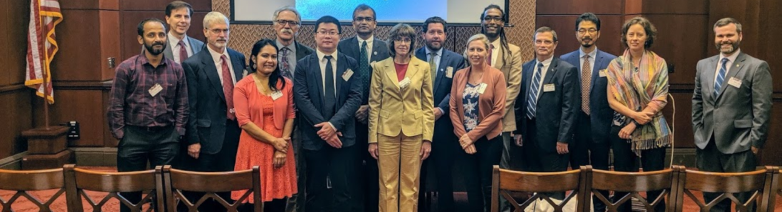
Two multistakeholder consultations
Two Technical Working Group meetings
FAO/MSU/WB First multistakeholder consultation
World Bank HQ, Washington, DC, April 2018
FAO/MSU/WB/Norad/NVI Second multistakeholder consultation
OIE HQ, Paris, January 2019
140 delegates
70 countries
including EU
FAO COFI SubCommittee on Aquaculture 10th Session
Technical Working Group meeting
FAOLOW, Washington, DC, July 2019
Technical Working Group meeting
FAO HQ, Rome, March 2019

Slide 10
PMP/AB 4 stages: risk-based, collaborative, progressive
Enhanced biosecurity and preparedness
Stage 4
Sustainable
biosecurity and health management systems established to support national aquaculture sector
Stage 2
Stage 3
Biosecurity risk defined
Biosecurity systems implemented
Stage 1
Biosecurity action plans = gateway passes to move from one stage to another
Risk assessment and emergency preparedness – all stages

Slide 11
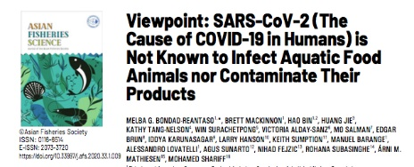
Viewpoint paper: SARS-CoV-2 (The Cause of COVID-19 in Humans) is Not Known to Infect Aquatic Food Animals Nor Contaminate Their Products
19 experts: aquatic animal health, aquaculture, fisheries, foodfish safety, virology and veterinary (aquatic and terrestrial) specialists
Rapid risk assessment
Objective: in response to the need for clear communication on the risk of transmission of the novel SARS-CoV-2 causing COVID-19 in humans and the general societal concern of potential contamination of aquatic animals used as food or their products with the virus.
https://www.asianfisheriessociety.org/publication/abstract.php?id=1291

Slide 12
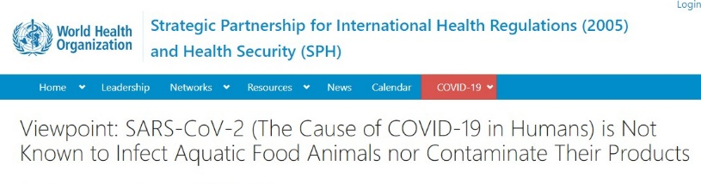
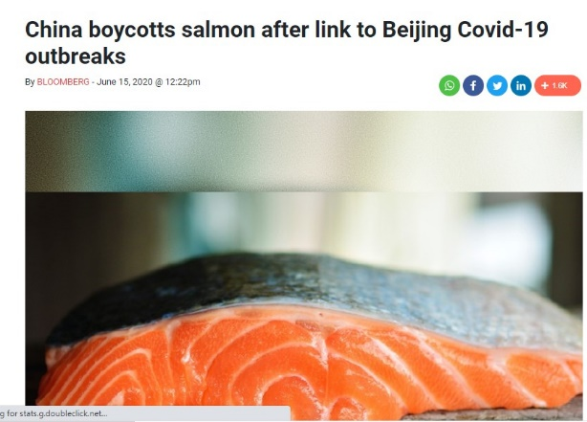
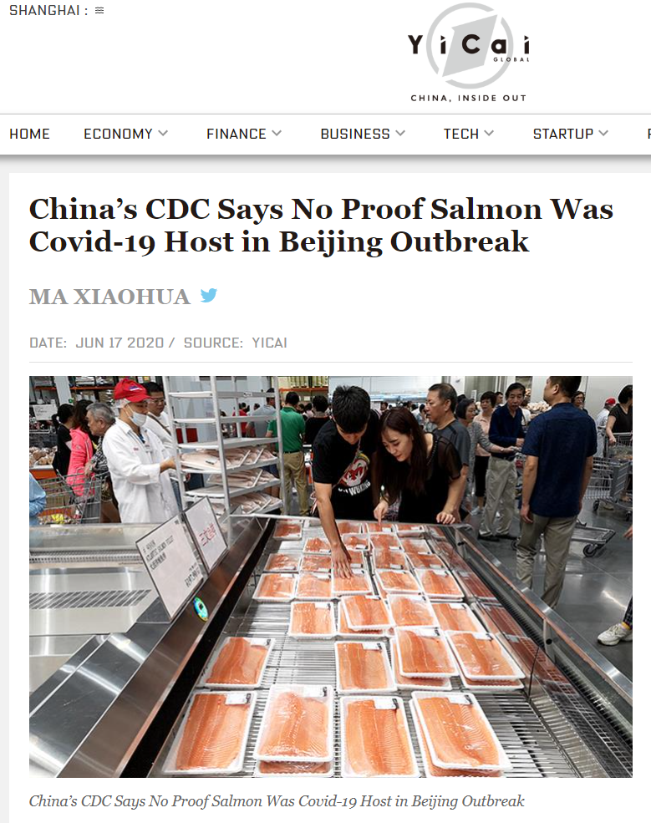
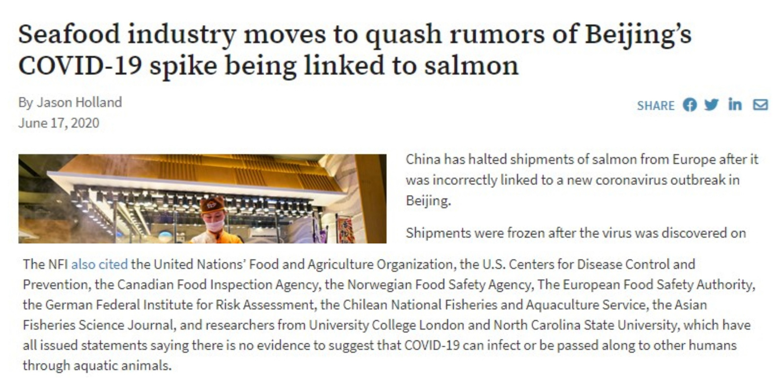
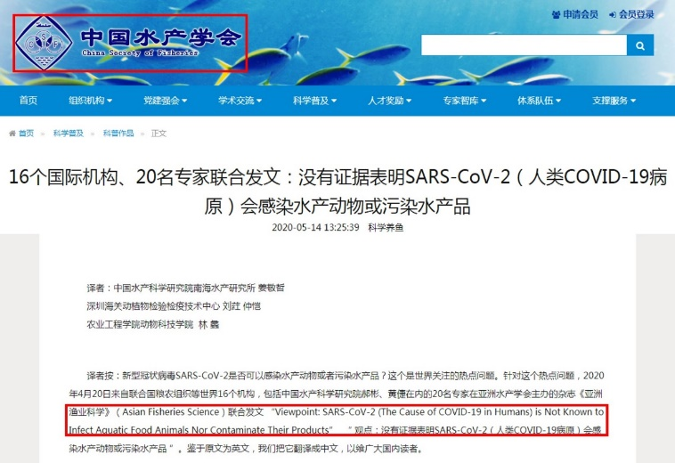
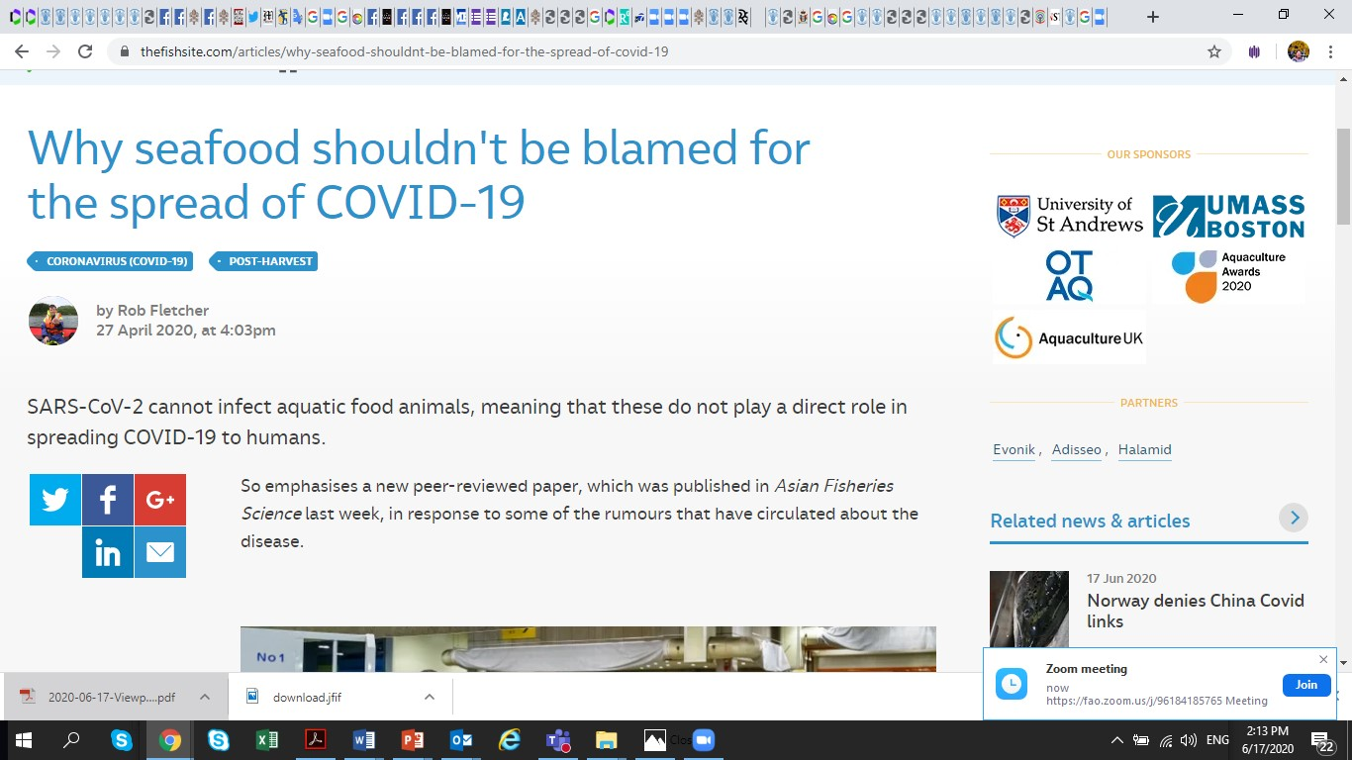

Slide 13
Expert knowledge and available literature | Findings
Viruses affecting major aquatic food animals | Very diverse and belong to multiple genera within more than 20 virus families; none of which belongs to the Coronaviridae family. No known zoonotic viral diseases associated with aquatic food animals
Target organ and pathology | SARS-CoV-2 primarily targets the upper and lower respiratory tract with the pathology of most consequence in the lung. Fish do not have lungs, with the exception of lungfish , and are therefore not susceptible to the virus.
ACE2 receptor | Comparison of human ACE2 receptor with that of a finfish, showed amino acid sequence identity of only 59 % (Chen et al., 2020). The very low genetic similarity of ACE2 receptors, therefore, negates the possibility of the virus infecting aquatic food animals. SARS-CoV-2 would need to undergo mutations to be able to attach to cells in these animals.

Slide 14
VIEWPOINT | Key messages
SARS-CoV-2 not known to infect aquatic animals used as food nor contaminate their products. Such animals do not play an epidemiological role in spreading COVID-19 to humans As with any surface, these animals and their products may potentially become contaminated with SARS-CoV-2 when handled by people who are infected and actively shedding the virus. Actual risk of contact with contaminated products is unknown, thus seafood is safe to consume, as long as it is prepared and served in accordance with recommended hygiene and food safety measures (Codex Alimentarius, 2020; WHO. 2020) Health of humans and animals are interrelated with the environment, a concept known as “One Health”; thus, health of all living organisms is of paramount importance. Good aquaculture practices and biosecurity will produce healthy source of aquatic animal protein. Many unknowns regarding SARS-CoV-2. As new information becomes available through peer-reviewed studies, we continuously improve our understanding of the virus and assess any potential risks to aquatic food systems that may arise.

